Slide 1
Computer Networks
Protocol Layering –
TCP/IP & OSI Model
S.V.Jansi Rani
Associate Professor / CSE
Notes:
The University of Adelaide, School of Computer Science
Chapter 2 — Instructions: Language of the Computer

Slide 2
Agenda
Protocol Layering
Each Layer in detail
Encapsulation
OSI Model
Notes:
The University of Adelaide, School of Computer Science
Chapter 2 — Instructions: Language of the Computer

Slide 3
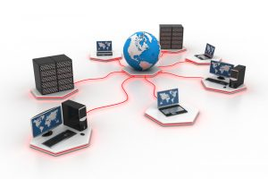


Slide 4
Protocol Layering
Protocol - the rules that both the sender and receiver and all intermediate devices need to follow to be able to communicate effectively.
Comm –simple- one simple protocol.
Comm- complex - divide the task between different layers - protocol layering.
Notes:
The University of Adelaide, School of Computer Science
Chapter 2 — Instructions: Language of the Computer

Slide 5
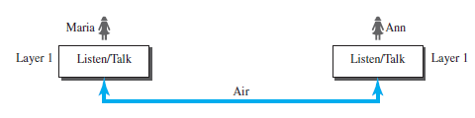
Maria and Ann are neighbors with a lot of common ideas. Communication
between Maria and Ann takes place in one layer, face to face, in the same language

Slide 6
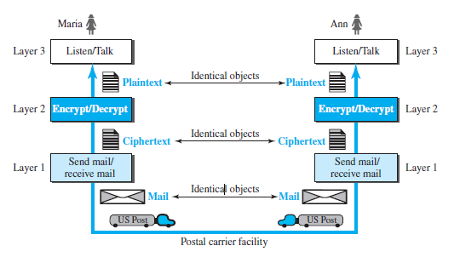
Three Layer Protocol

Slide 7
Advantages - PL
Protocol layering enables us to divide a complex task into several smaller and simpler tasks.
It allows us to separate the services from the implementation
Communication does not always use only two end systems; there are intermediate systems that need only some layers, but not all layers. If not PL, we would have to make each intermediate system as complex as the end systems -Expensive.

Slide 8
Principle of PL
Bidirectional communication -need to make each layer so that it is able to perform two opposite tasks
Two objects under each layer at both sites should be identical

Slide 9
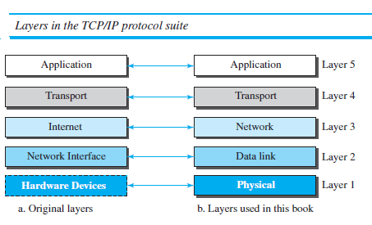
TCP/IP
It is a hierarchical protocol made up of interactive modules, each of which provides a specific functionality

Slide 10
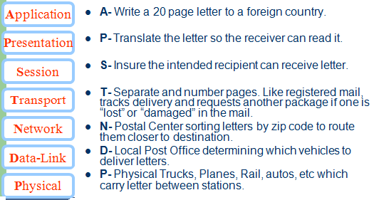

Slide 11
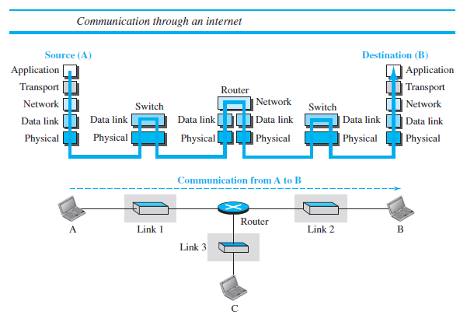

Slide 12
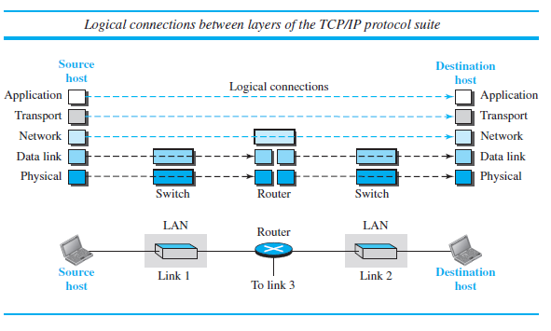

Slide 13
Domain
  L1,L2 – link
  L3 to L5 - Internet
Data units (packets) – not changed by other, Lower two – changed by routers

Slide 14
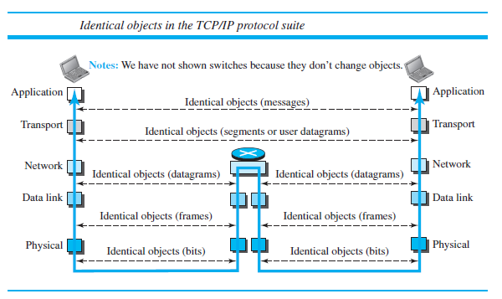

Slide 15
Physical Layer
Responsible for carrying individual bits in a frame across the link.
Bits received in a frame from the data-link layer are transformed into signals in transmission media
Physical characteristics of interface and medium
Representation of bits
Data rate
Synchronization of bits
Line configuration
Physical topology
Transmission mode

Slide 16
Data Link Layer
Internet is made up of several links (LANs and WANs) connected by routers.
Overlapping sets of links that a datagram can travel
from the host to the destination.
The routers are responsible for choosing the best links.
Hop to hop delivery
Data-link layer is responsible for taking the datagram and moving it across the link.
DL - frame.
DL -error detection and correction
Flow Control
Access Control
Physical addressing

Slide 17


Slide 18
Network Layer
NL -creating a connection between the source computer
and the destination computer.
Host-to-host connection
Routers - choosing the best route for each packet.
The network layer in the Internet - Internet Protocol
- defines the format of the packet, called a datagram at the network layer, addressing.
IP is a connectionless protocol that provides no flow control, no error control, and no congestion control services , which is taken care by the transport-layer protocol.
A routing protocol does not take part in routing (it is the responsibility of IP), but it creates forwarding tables for routers to help them in the routing process.
Logical Addressing

Slide 19
Network Layer
Auxiliary protocols that help IP in its delivery and routing tasks.
  The Internet Control Message Protocol (ICMP) helps IP to report some problems when routing a packet.
  The Internet Group Management Protocol (IGMP) is another protocol that helps IP in multitasking. The Dynamic Host Configuration Protocol
  (DHCP) helps IP to get the network-layer address for a host.
  The Address Resolution Protocol (ARP) is a protocol that helps IP to find the link-layer address of a host or a router when its network-layer address is given..

Slide 20


Slide 21
Transport Layer
Process to Process delivery (end to end) of segments.
Transmission Control Protocol (TCP), is a connection-oriented protocol that first establishes a logical connection between transport layers at two hosts before transferring data.
Segmentation and Reassembly
Service point addressing (port numbers)
TCP provides flow control, error control, and congestion control
User Datagram Protocol (UDP), is a connectionless protocol that transmits user datagram without first creating a logical connection
UDP is a simple protocol that does not provide flow, error, or congestion control.
Stream Control Transmission Protocol (SCTP) is designed to
respond to new applications that are emerging in the multimedia.

Slide 22


Slide 23
Application Layer
The logical connection between the two application layers is end to end.
The two application layers exchange messages between each other as though there were a bridge between the two layers.
Communication at the application layer is between two processes (two programs running at this layer).
Enables user to access network
Provides user interface and support services such as
  Electronic mail
  Remote file access and transfer
  Shared DB management
  Network virtual terminal
  Directory services

Slide 24

Protocol Layering
Notes:
The University of Adelaide, School of Computer Science
Chapter 2 — Instructions: Language of the Computer

Slide 25


Slide 26
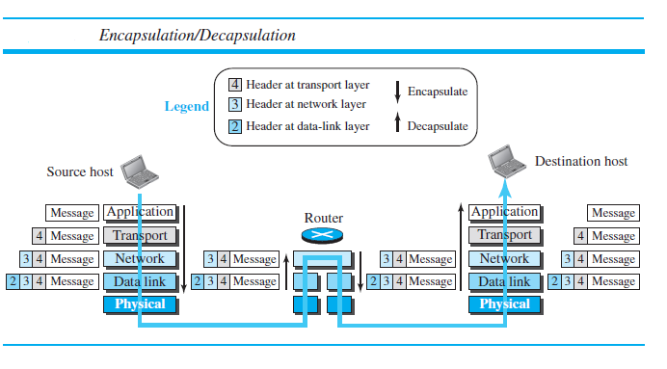

Slide 27
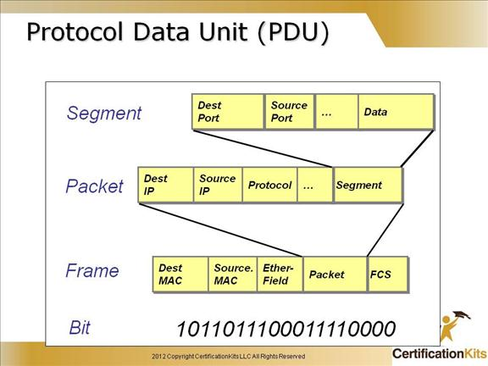

Slide 28
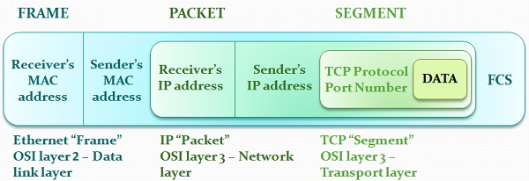

Slide 29
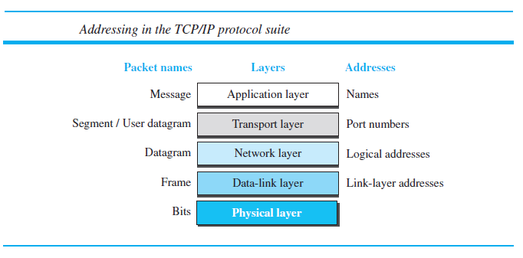

Slide 30
Multiplexing
Multiplexing means that a protocol at a layer can encapsulate a packet from several next-higher layer protocols (one at a time)
Demultiplexing means that a protocol can decapsulate and
deliver a packet to several next-higher layer protocols
Multiplexing is the process of combining two or more data streams into a single physical connection.
TCP provides multiplexing facilities by using source and destination port numbers. These port numbers allow TCP to set up a number of virtual connections over a physical connection and multiplex the data stream through that connection.

Slide 31
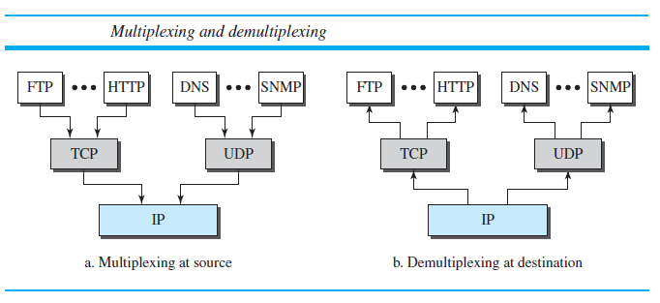

Slide 32


Slide 33
Open Systems Interconnection (OSI)
An open system is a set of protocols that allows any two different systems to communicate regardless of their underlying architecture.
Purpose - how to facilitate communication between different systems without requiring changes to the logic of the underlying hardware and software.
The OSI model –not protocol but model
Basis for creation of the protocols in the OSI stack
The OSI model is a layered framework for the design of network systems that allows communication between all types of computer systems

Slide 34
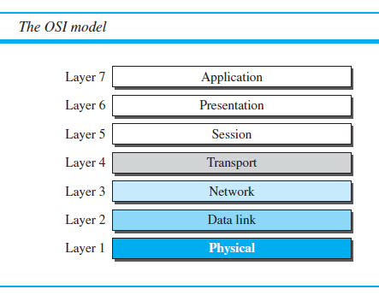

Slide 35
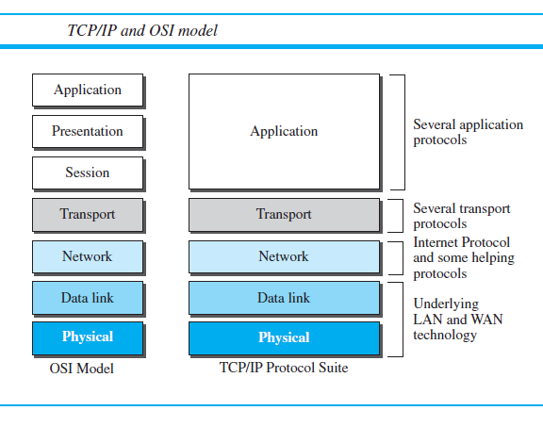

Slide 36
Presentation Layer
Translation
Encryption
Compression

Slide 37
Session Layer
Dialog control
Synchronization

Slide 38
Application Layer

Slide 39
Lack of OSI Model’s Success
First, OSI was completed when TCP/IP was fully in place and a lot of time and money had been spent on the suite; changing it would cost a lot.
Second, some layers in the OSI model were never fully defined
Third, when OSI was implemented by an organization in a different application, it did not show a high enough level of performance

Slide 40
Test Your Understanding
Please attend the Quiz in Google Form

Slide 41
THANK YOU

